Slide 1
IBM Stock Trader sample for Kubernetes – Basic
Kubernetes (OCP, EKS, AKS, IKS, GKE, TKG)
IBM Cloud
Stock Quote
GET
API Connect
GET
IEX
JDBC
DB2
Trader (Java UI)
Portfolio
GET
Insert, Select,
Update, Delete
POST/GET
PUT/DELETE
Browser
Broker
Legend:
Blue: Open Liberty
Red: Quarkus
Green: Dependency
This open-source application demonstrates how to build a cloud-native application out of microservices, which connect to services in the cloud. There is a GitHub org, at https://github.com/IBMStockTrader, which contains a repository per microservice, as well as an operator repository and a GitOps repository.
When code is committed to a microservice repository, a webhook kicks off a GitHub Action that builds and pushes an image to Quay, and updates a StockTrader CR yaml in the GitOps repo with the tag for the new image, which kicks off another GitHub Action that deploys/updates the application to a Kubernetes cluster in the cloud.

Slide 2
IBM Stock Trader sample for Kubernetes – with optional pieces
Solid Border:
Required
Dashed Border:
Optional
Kubernetes (OCP, EKS, AKS, IKS, GKE, TKG)
IBM Cloud
loopctl
Looper
Stock Quote
GET
API Connect
Jedis
Redis
GET
IEX
GET
SET
DB2
Trader (Java UI)
Portfolio
JDBC
GET
Insert, Select,
Update, Delete
POST/GET
PUT/DELETE
GET, POST
Cloudant
Browser
Broker
Account
GET
IBM
ODM
JMS
Put
Legend:
Blue: Open Liberty
Red: Quarkus
Purple: tWAS
Yellow: Node.js
Green: Dependency
Tradr (Node UI)
IBM
MQ
POST
Watson Tone Analyzer
Kafka Send
Notification Service
MDB
onMessage
Notification (Slack)
IBM Event Streams
Messaging
POST
Slack
POST
IBM Cloud Functions
POST
Uses an Istio routing rule here
Kafka
Receive
GET
Trade History
GET
Mongo
Notification (Twitter)
POST
Twitter
POST
Twitter4J

Slide 3
Stock Trader using hyperscaler services – AWS
EKS (using ECR)
AWS Services
Solid Border: Required
Dashed Border:
Optional
Stock Quote
putObject
Insert, Select,
Update, Delete
RDS (Aurora)
S3
Browser
Trader
GET
JDBC
Portfolio
Publish
MSK
Elasti Cache
Jedis
POST/GET
PUT/DELETE
Subscribe
Trade History
GET
SET
Broker
Watson Tone Analyzer
GET
Document DB
POST
POST
loopctl
GET
Account
GET
Looper
CouchDB
PUT
JMS Put
Amazon
MQ
POST
GET
IEX
JMS Get
Notification Service
Notification (Slack)
getStockQuote
Slack
MDB
onMessage
getLoyaltyLevel
POST
Legend:
Blue: Open Liberty
Yellow: Node.js
Green: AWS Service
Orange: Other Service
Messaging
Lambda
API Gateway
Lambda
Pick either the Slack or Twitter microservice
postLoyaltyLevelToSlack
Lambda
POST
Notification (Twitter)
Twitter
POST
Twitter4J
Notes:
We use PostgreSQL (JDBC) compatibility mode in Aurora in the Relational Database Service (RDS)
We use ActiveMQ (JMS) compatibility mode in Amazon MQ
We use Kafka (MicroProfile Reactive Messaging) with MSK
We use Redis (Jedis) via ElastiCache
We have 3 Lambda functions (exposed via the AWS API Gateway): getStockQuote, getLoyaltyLevel and postLoyaltyChangeToSlack

Slide 4
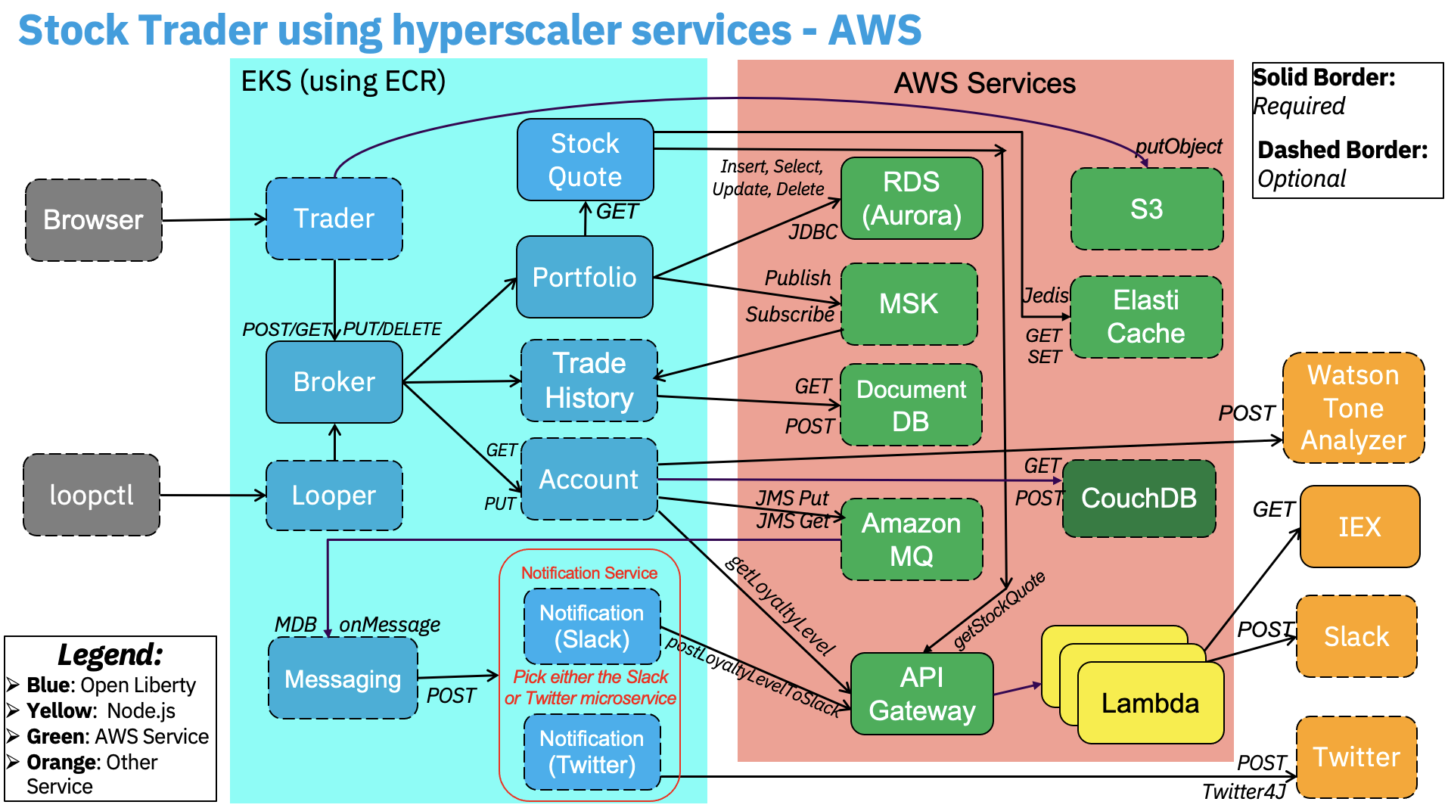
Stock Trader CI/CD – GitHub Actions as pipeline technology
GitHub Action for GitOps repo
Could instead use Argo CD or Flux to drive updates to the cluster when the CR yaml is updated in the GitOps repo, instead of coding that into GH Action
Log in & apply CR yaml to desired Kube cluster
Operator creates requested Kube resources
Such as EKS
Such as Deployments, HPAs, etc.
Commit code in any microservice repository
Build code, tag & push image to container registry
Update CR yaml in GitOps repo with new tag
Such as portfolio
Such as ECR
stocktrader-gitops
GitHub Action per microservice

Slide 5
The “umbrella” operator for the IBM Stock Trader sample
https://github.com/IBMStockTrader/stocktrader-operator
Wraps the helm chart at https://github.com/IBMStockTrader/stocktrader-helm
Described at https://medium.com/hybrid-cloud-engineering/the-ibm-stock-trader-operator-part-1-usage-9737a04b6848
Handles installation and configuration of the sample
No “day 2” operations – but does support altering the configuration and pushing that out
All microservices installed by single operator
The application as-a-whole is described by the CR you create from the CRD
No having to install each microservice separately
Can install the sample via a single “oc apply -f stocktrader.yaml” command, or via the form UI
Prerequisite services are NOT installed by this operator
Helps configure connections to pre-provisioned prereq services
Might be interesting to explore an “operator of operators” pattern
Could potentially drive the IBM Cloud operator to help with hooking up to resources out in our cloud
Also looking into using Crossplane to configure the prereq services

Slide 6
MicroProfile features used in IBM Stock Trader
Green means the feature is explicitly used
Yellow means the feature is not explicitly used, but out-of-the-box behavior is implicitly available
Red means no usage of the feature
The non-Liberty microservices, like the Node.js-based Tradr and the tWAS-based Notification-Twitter, are not shown here since there is no MicroProfile available there
Messaging is the only traditional EJB-based microservice. It’s an MDB with no http endpoint
We usually use the fault tolerance features of the OpenShift Service Mesh (Red Hat’s productization of Istio) in lieu of MicroProfile Fault Tolerance
MicroProfile REST Client (with JSON-B) is used for all http/https calls between microservices
Trade History also uses mpReactiveMessaging

Slide 7
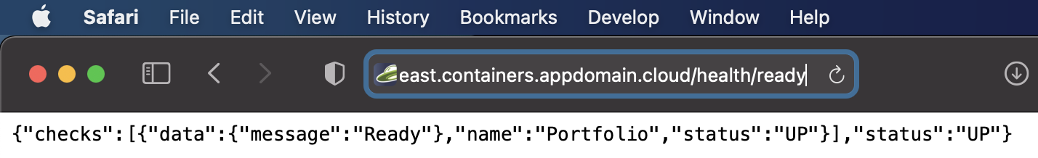
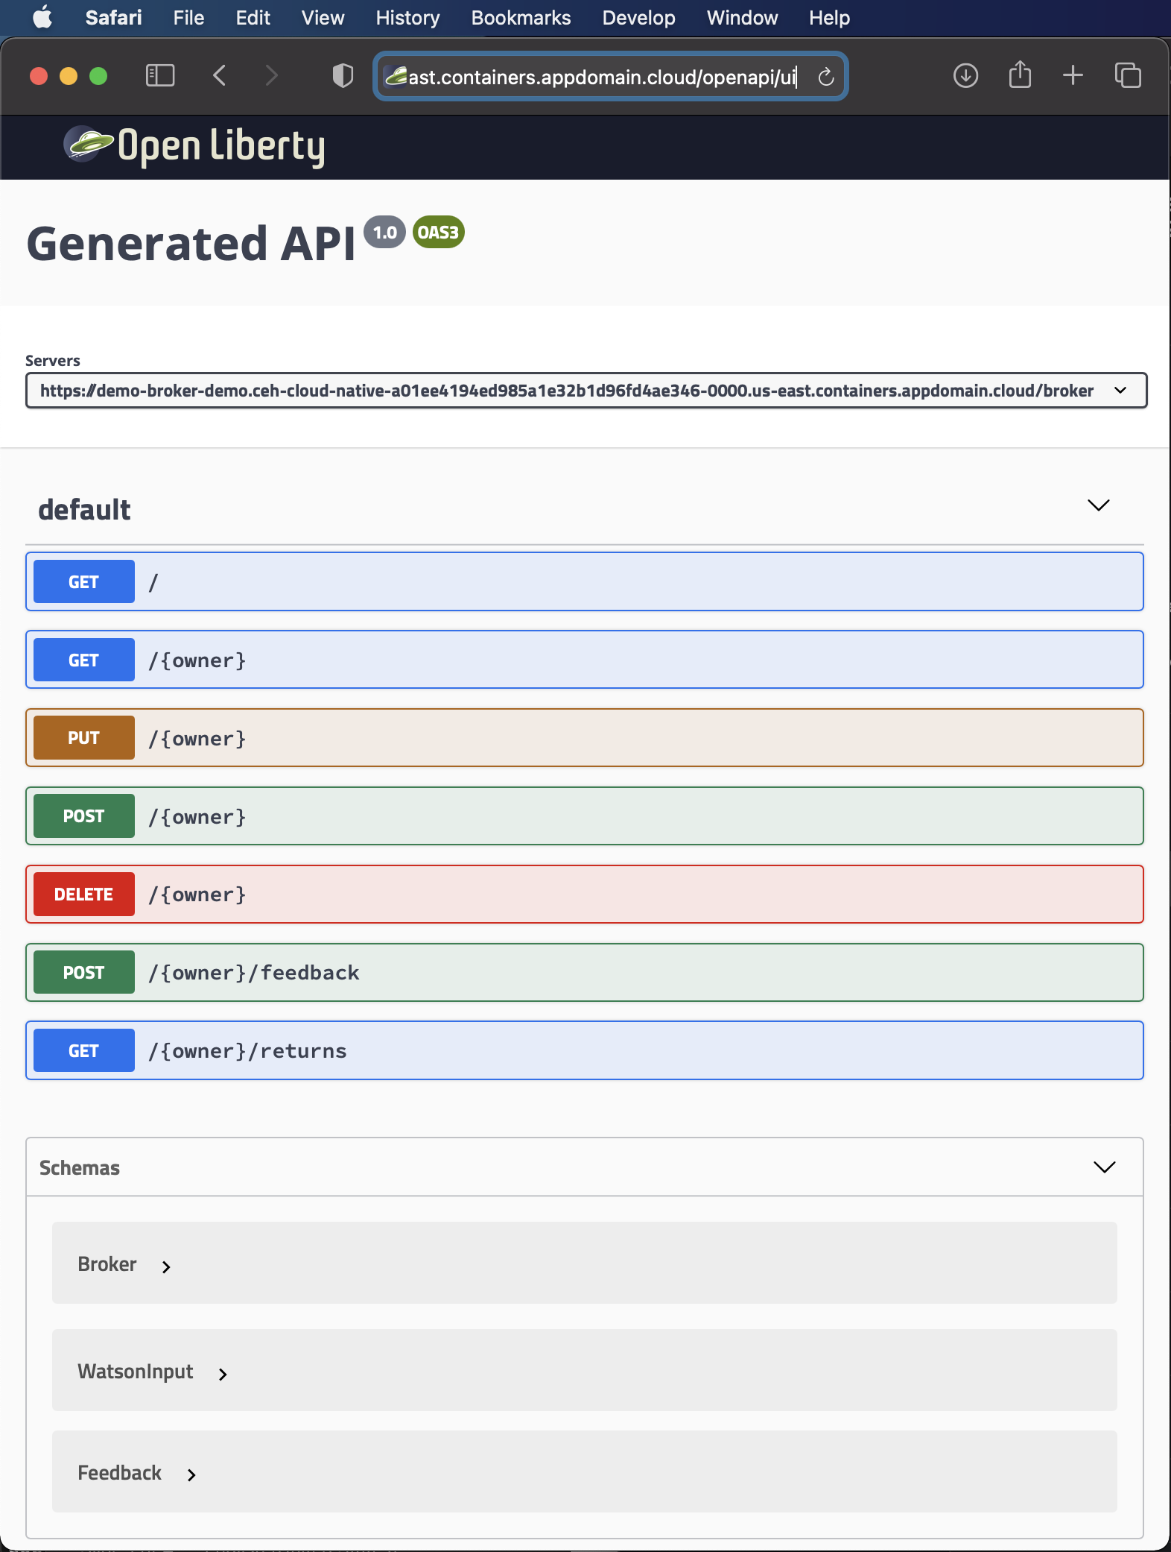
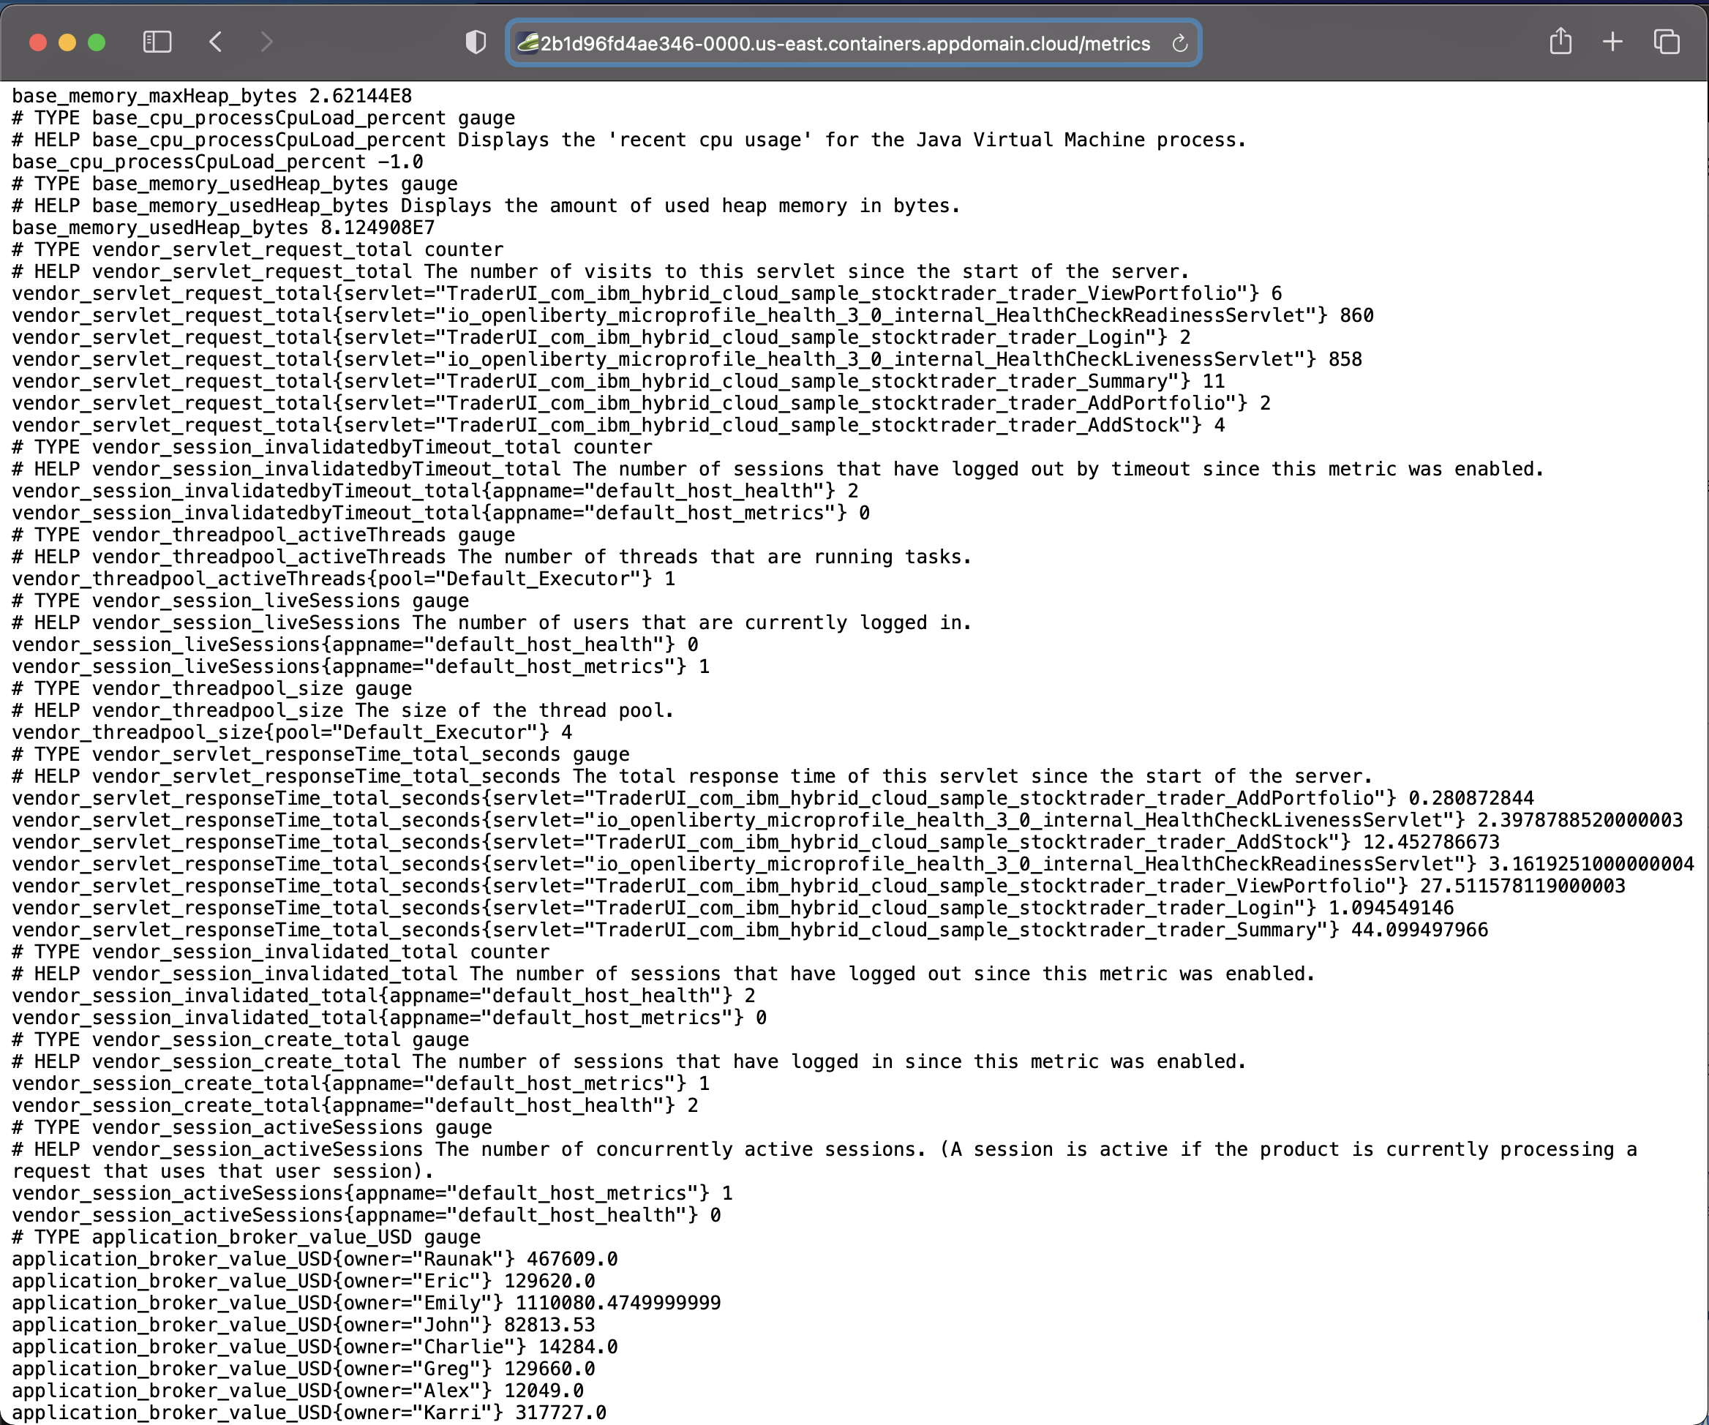
MicroProfile endpoints from IBM Stock Trader
Health:
OpenAPI:
Metrics:

Slide 8
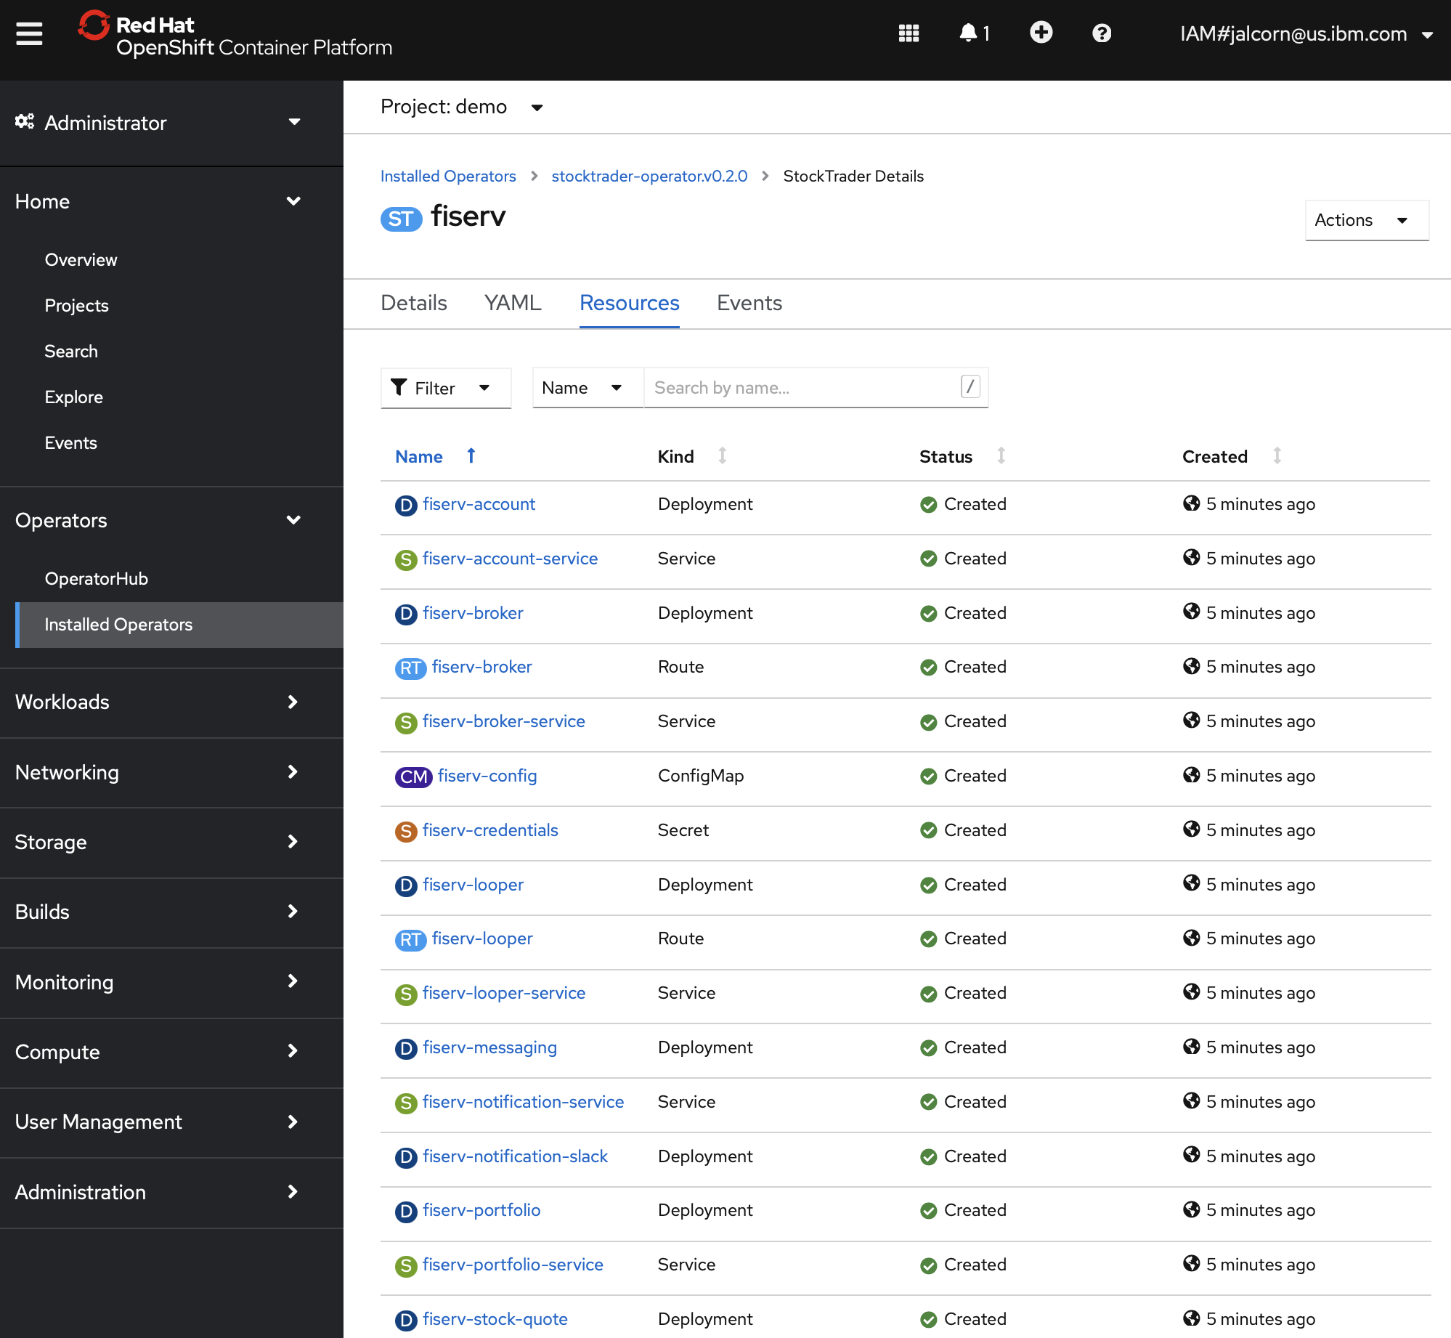
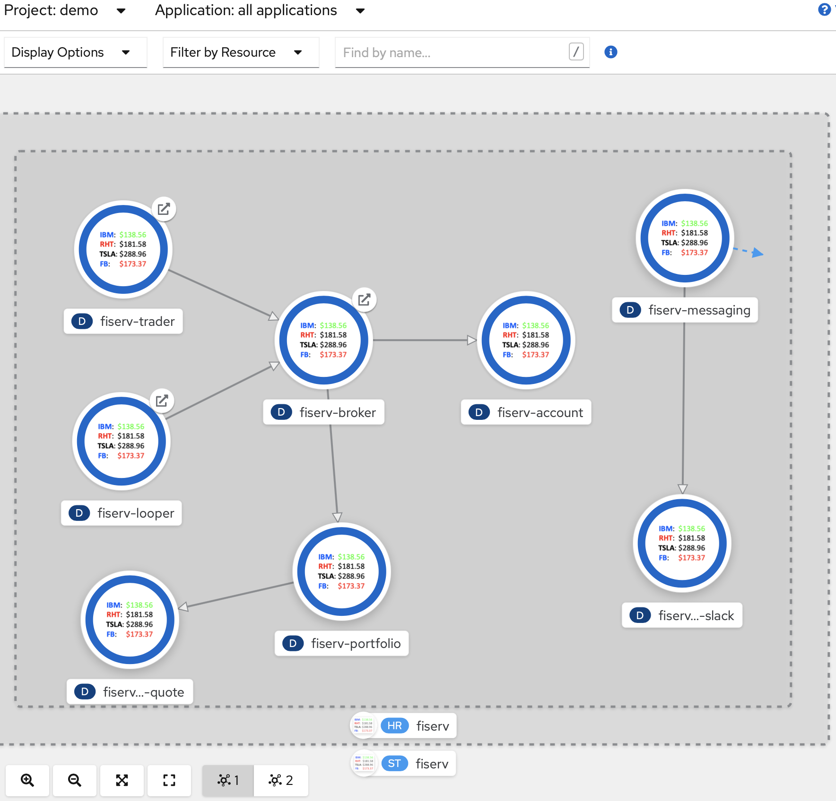
IBM Stock Trader microservices visualized in the OpenShift console

Slide 9
CQRS in IBM Stock Trader
Broker
GET /broker
javax.cache
Looper
Broker Query
RH Data Grid
GET /broker/{owner}
(or other JCache provider like Redis or Hazelcast)
(or other JDBC provider)
Trader
POST /broker/{owner}
Portfolio
DB2
PUT /broker/{owner}
Kafka
Tradr
(Confluent or RH AMQ Streams)
DELETE /broker/{owner}
Account
Cloudant
CQRS would be optional (based on a boolean in the CRD, set via the form in the operator and passed as an env var to each pod). If not enabled, the GET calls would go to Portfolio and Account like usual, and nothing would get published to Kafka

Slide 10




Source for Stock Trader footer image
https://github.com/IBMStockTrader
Source for Stock Trader helm chart/operator icon
IBM: $138.56
RHT: $181.58
TSLA: $288.96
FB: $173.37

Slide 11
Approaches for HashiCorp Vault integration with microservices
Code directly to Vault in your microservice Java classes
Pros: Very secure – secrets not exposed in files or env vars
Cons: Must train developers to use proprietary code in every microservice, and vendor lock-in to HashiCorp as the secrets manager
Use the Vault injector to get an init container and sidecar
Pros: No impact to developers, and no vendor lock-in for microservices
Cons: Overhead of extra containers per pod, and risk of secrets getting disclosed to unauthorized parties that might see the files or env vars
*New*: Use the VaultConfigSource for MicroProfile Config
Pros: No impact to developers (if already using standard MicroProfile programming model of CDI injection of config properties), and no vendor lock-in. Also, no overhead of extra containers per pod, or disclosure risk
Cons: None!

